Slide 1
Examining the Waveform of Resonant EMRIs vs Single EMRIs
Christopher Goodhart

Slide 2
Purpose
To determine if we can detect a resonant EMRI signal, or if the signal will be confused with another type of system.

Slide 3

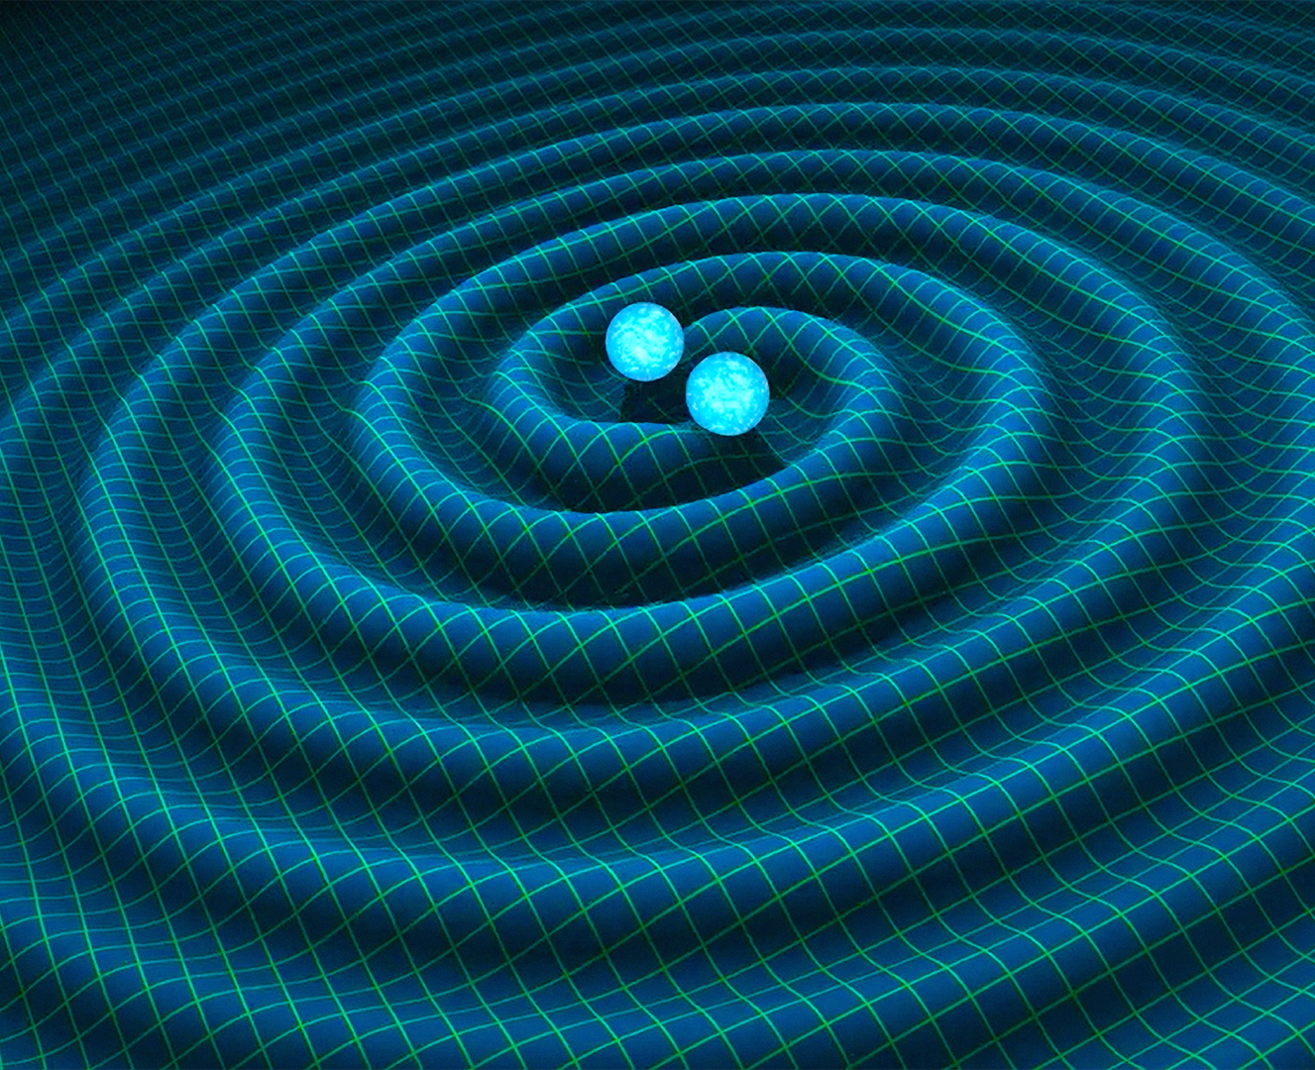
Introduction
Gravitational Waves (LIGO Caltech)
Ripples in spacetime
Modelled by general relativity
Only detectable from high energy events

Slide 4
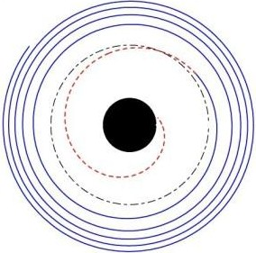
Introduction
EMRI--Extreme Mass Ratio Inspiral
One BH at least 10,000 times more massive than other
Smaller ones orbits and spirals inward
Orbit decays because EMRI emits gravitational waves

Slide 5
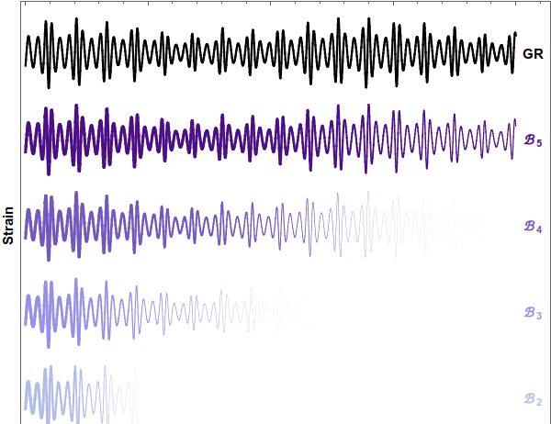
Past Research
A single EMRI with an external tidal field (Yang, H. et al, 2017)
Worked on differentiating between signals and glitches (Cornish, N. J., 2010)
Modelled EMRIs around "bumpy" black holes (Emparan, R. et al, 2014)
Effect of transient resonances on EMRI systems (Berry, C. P. L. et al, 2017)

Slide 6
Importance
Gravitational waves are a way to see the universe
EMRIs are a great source of gravitational wave signals
Signals have abundant information
Formation of supermassive black holes
Insights to the fundamentals of gravity
Test numerous theories regarding relativity

Slide 7
Hypothesis
The signal from a resonant EMRI will differ from a single EMRI , but will be detectable by current methods.

Slide 8
Variables
Independent variable: Number of EMRIs
Dependent variable: Gravitational wave signal
Constants: As many parameters as possible
Mass, angular momentum, charge, spin
Control: Single EMRI

Slide 9
Method
Use Python to simulate EMRI systems
1
Model the waveforms of various EMRIs
2
Compare the waveforms of resonant EMRIs to single EMRIs
3

Slide 10
Simulation (Step 1)
Input parameters (mass, number of EMRIs, angular momentum)
Simulation runs, displaying the orbit of EMRIs overtime before collision
Maximize physics of simulation; ex: post-Newtonian equations
Run simulation for both single EMRIs and resonant EMRIs

Slide 11
Modelling Waveform (Step 2)
For each simulation, create a model of the gravitational wave signal
Waveform is graphed overtime with the model
Create the waveform for single EMRIs and resonant EMRIs

Slide 12
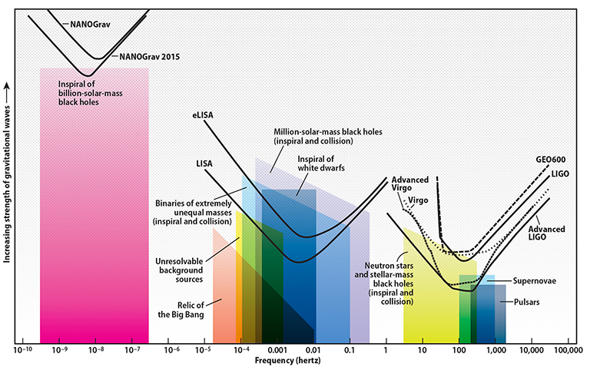
Compare Waveforms (Step 3)
Look for defining characteristics of the signal
Look for major differences that show up
Determine if signal can be detected by LISA (Engelking, C. et al 2017).
Compare signal to other sources

Slide 13
Feasibility
Need a laptop that can run python
Internet access
Need python packages to program simulation
No risks involved

Slide 14
References
Berry, C. P. L., Cole, R. H., Canizares, P., & Gair, J. R. (2017). Understanding The Importance of Transient Resonances in Extreme Mass Ratio Inspirals. Journal of Physics: Conference Series.
Cornish, N. J. (2010). Separating Gravitational Wave Signals From Instrument Artifacts. Physical Review D, 82, 1-21.
Emparan, R., Figueras, P., & Martinez, M. (11 Dec 2014). Bumpy Black Holes. Cornell University Library.
Engelking, C. & Andrews, B. (3 Oct. 2017). Astronomers Have Finally Found Evidence of Gravitational Waves. Discover Magazine.
Favata, M. (22 Jan. 2011). Black Holes And Gravitational Waves: A Brief Introduction. Cornell University.

Slide 15
References
LIGO Caltech (N. D.). What are Gravitational Waves?
Moore, C. J., Chua, A. J. K., & Gair, J. R. (13 Sep. 2017). Gravitational Waves From Extreme Mass Ratio Inspirals Around Bumpy Black Holes. Class. Quantum Grav.
Morrow, A. (Feb. 2016). NSF's LIGO Has Detected Gravitational Waves. NASA.
Temming, M. (6 Aug. 2015). Bumpy Black Hole X-Rays May Push the Limits of Einstein's Relativity. Scientific American.
Yang, H. & Casals, M. (2017). General-Relativistic Dynamics of an Extreme Mass-Ratio Binary with an External Body.

